Slide 1


SoundSight Companion
Empowering Independence through Auditory Vision
By Octagram

Slide 2
What is SoundSight Companion??
Visually impaired individuals face challenges in understanding their environment.
Our solution SoundSight Companion aims to revolutionize the way visually impaired individuals perceive their surroundings. By leveraging advanced object detection algorithms and contextual image analysis, we enable users to explore the world by allowing them to upload images and receive detailed audio descriptions of objects detected, along with contextual information about the environment captured in the image.
SoundSight Companion offers a seamless and user-friendly experience, enabling visually impaired individuals to comprehend their surroundings effectively

Slide 3
Features of the Solution
Real-Time Detection
Contextual Information
Process uploaded images in real-time to provide swift audio descriptions and environment analysis.
Enhance user understanding with detailed information about the surroundings captured in the image.
Audio Output Generation
Translate the detected objects and environmental context into clear and concise audio descriptions..
User-Friendly Interface
Cross Platform Accessibility
Offer an intuitive and accessible interface for seamless interaction, making the solution easy to use for visually impaired individuals.
Accessible across different platforms, including smartphones and computers, to accommodate various user preferences and device availability.

Slide 4

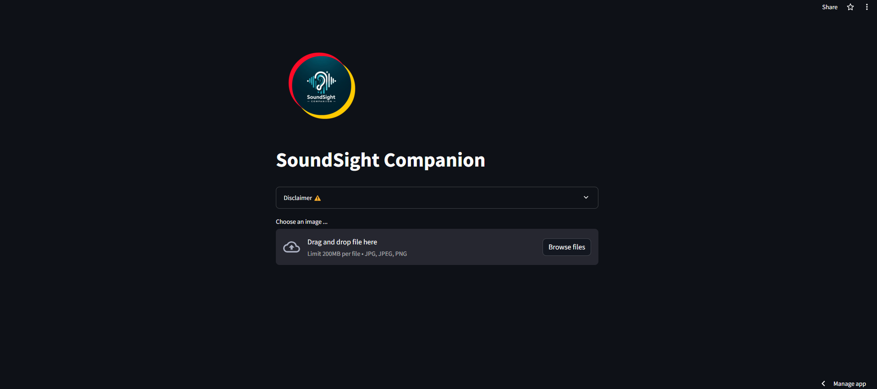

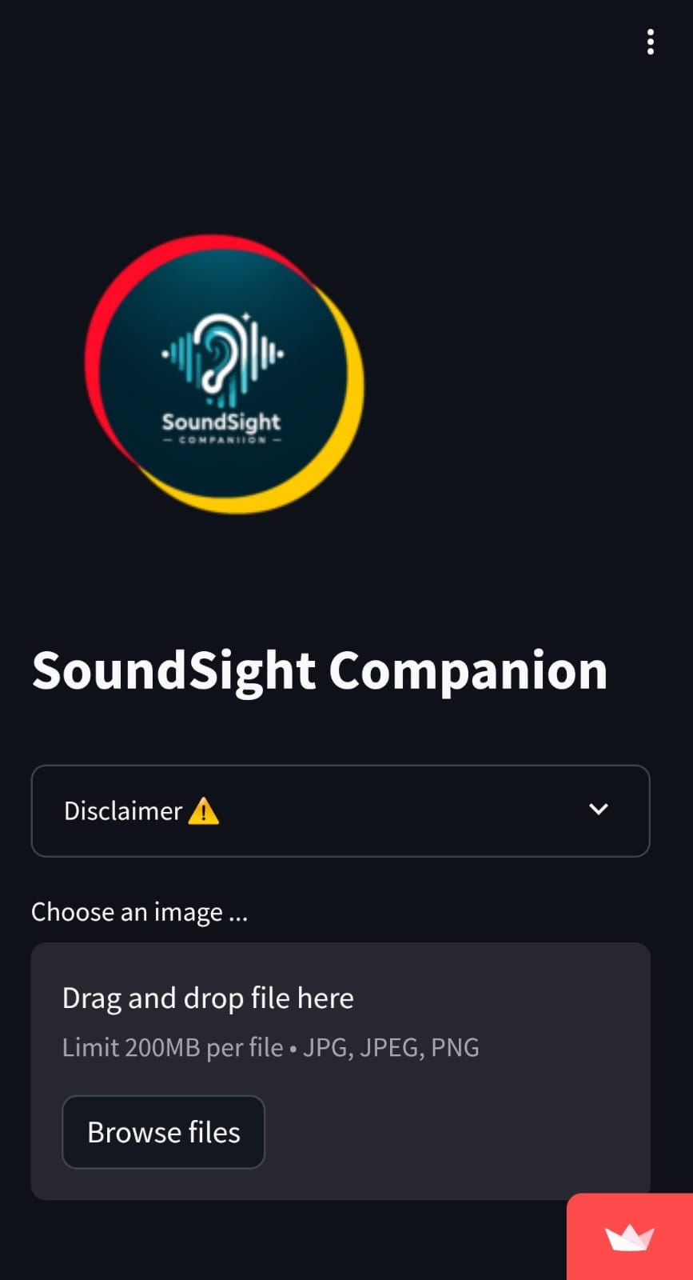
How our web-app looks

Slide 5
Benefits to Visually Impaired Individuals
1
Enhanced Independence
2
Improved Safety
Empower individuals to navigate their surroundings independently, improving their overall quality of life.
Enable individuals to better identify potential hazards and navigate safely in various environments.
3
Efficient Information Retrieval
4
Personal Empowerment
Provide visually impaired individuals with detailed information about the objects and environment they encounter. Streamlines the process of obtaining contextual information, making it more accessible and immediate.
Fosters a sense of empowerment and self- confidence among visually impaired individuals. Encourages a positive mindset and a proactive approach to exploring and interacting with the world.

Slide 6

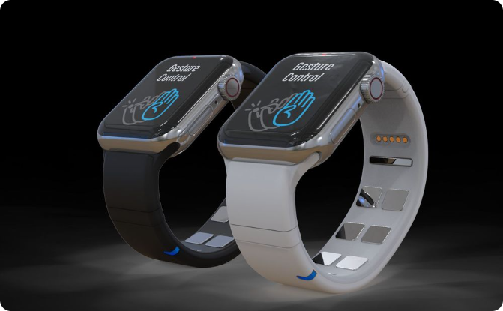
Future Enhancements
Multilingual Audio Output Support
Wearable Device Integration
Enable multilingual audio support to further improve accuracy and enhance the user experience.
Will Investigate on the integration of the solution into wearable devices for a more seamless and portable experience.

Slide 7
THANK YOU

